Slide 1
Overview of Agile
Project Management Methodology
Presentation by Hanna Asiadouskaya

Slide 2
What is the Agile methodology?
The Agile methodology is a project management approach that involves breaking the project into phases and adjusting to changing requirements.
So, It focuses on delivering smaller pieces of work regularly instead of one big launch. Also, this allows teams to adapt to changes quickly and provide customer value faster.

Slide 3
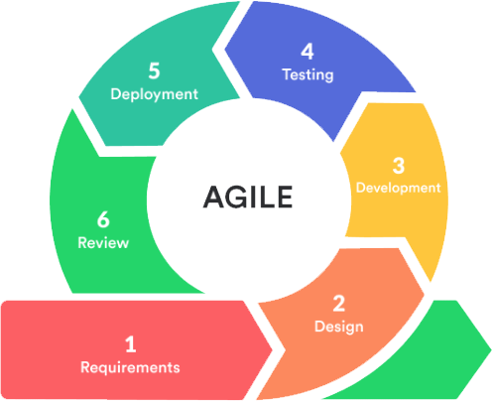
Life cycle of Agile Methodology
Requirement Gathering
Design
Development
Testing
Deployment
Review
Notes:
In this stage, the project team identifies and document the needs and expectations of various stakeholders, including clients, users, and subject matter experts. It involves defining the project’s scope, objectives and requirements. Establishing a budget and schedule. Creating a project plan and allocating resources.
Which includes planning for the software’s user interface. Creating detailed specifications, with data structures, algorithms, and interfaces.
Writing the actual code for the software. Conducting unit testing to verify the functionality of individual components.
There can be several types of testing, for example User Accepting testing, where we confirming that the software meets user requirements. Or for example performance testing - Assessing the system’s speed, scalability, and stability.
Deploying the software to a production environment and Make sure it works smoothly in the real world.
Releasing updates and patches to enhance the software and address problems.

Slide 4
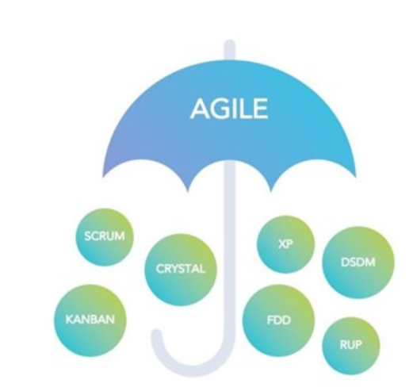
Types of Agile methodologies
Agile project management is not a singular framework but an umbrella term that includes a wide range of methodologies, including Scrum, Kanban, Extreme Programming (XP), and the Adaptive Project Framework (APF).

Slide 5
Benefits of Agile Methodology
Adapts to Changing Requirements
Time-Efficient
Frequent Changes
Prioritize customer satisfaction
Fosters collaborative teamwork
Notes:
It is a highly adaptable methodology in which rapidly changing requirements allowing responsive adjustments.
It is well-suited for its time-efficient practices, which help in delivering software quickly and reducing time-to-market.
It effectively manages and accommodates frequent changes in project requirements (according to stakeholder convenience).
teams can get feedback from their actual customers quickly and can focus on customer needs much more closely
Agile methodology encourages effective face-to-face communication.

Slide 6
Limitations of Agile Methodology
Less predictable
Lack of necessary documentation
Greater demands on developers and clients
Notes:
Due to it’s flexibility it’s harder to predict and estimate the time necessary, or quantify the resources and efforts required to complete a project.
Because tasks are often completed just in time for development under the Agile Method, documentation tends to be less thorough, which can lead to misunderstanding and difficulties down the road.
Agile demands more time and energy from everyone because developers and customers must constantly interact with each other

Slide 7
Popular Agile Tools for Software Development
An Agile Tool for software development is a software application or a platform that enables the teams to manage and track the Agile project more efficiently.
Some popular agile services are:
1.Jira
2.ClickUp
3.Mural
4.Kanbanize
5.GitHub
Where you can find:
- Interactive timelines
- Scrum and Kanban boards
Customizable workflows
Sprints
Some other tools that can be integrated on working flow:
Figma
Google sheets
Trello

Slide 8
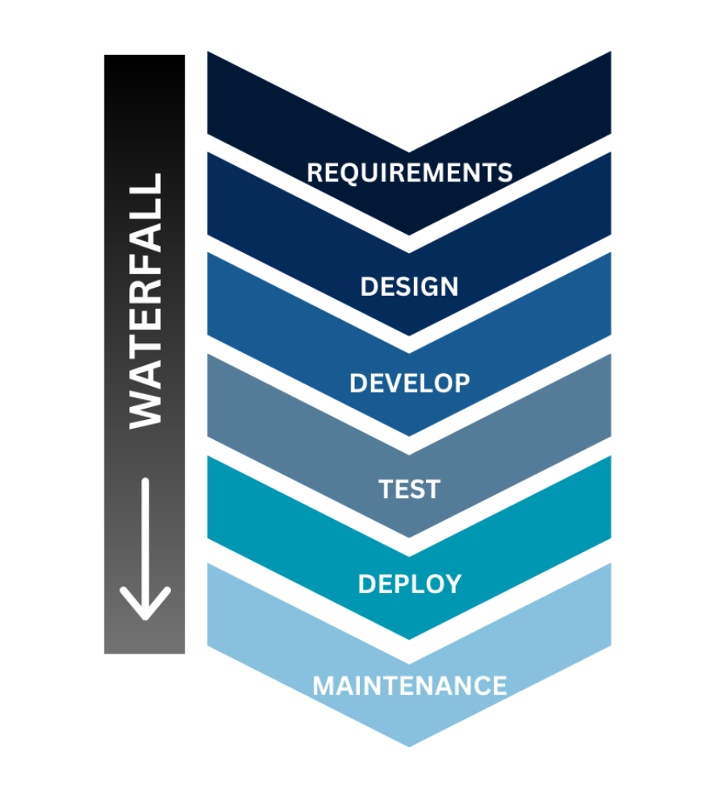
Waterfall
Waterfall methodology is a linear form of project management ideal for projects where the end result is clearly established from the beginning of the project. The expectations for the project and the deliverables of each stage are clear and are required in order to progress to the next phase.

Slide 9
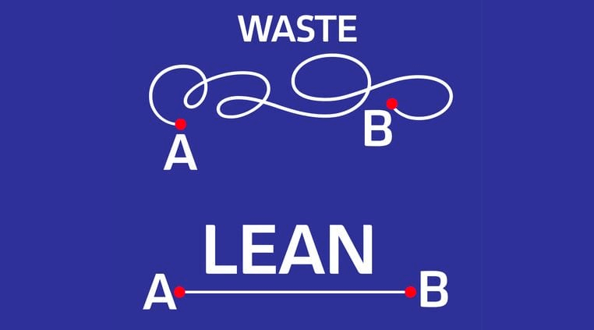
Lean
Lean methodology is a set of practices and principles aimed at the optimization of business processes, eliminating waste and improving operational flow.
The ultimate goal is to create a system that maximizes value while minimizing resource consumption. Lean project management’s core principles and methodologies help teams focus on waste reduction and continuous process improvement.

Slide 10
 | Waterfall | Lean | Agile
Requirements | Clearly-defined | Can Change | Can Change
Client Involvement | × | ✓ | ✓
Time frame | Strict | Strict | Loose
Budget | Strict | Strict | Big or unlimited
Team collaboration | Moderate | Intensive | Intensive
Type | Straight-forward solutions | Urgent and Small Projects | Complex Projects
Depending on the specific features of your project, implementing it with Agile may be more suitable, or it might thrive with the Waterfall approach. To make sure you go for the most beneficial software methodology, it is recommended to carefully analyze the following factors:
Notes:
1.Clarity of requirements — if the requirements are precise and are very unlikely to change, then Waterfall is a good choice. But if the concept is vague and could have multiple changes, it will definitely work better with Agile or Lean, as they both repetitive.
2. Depth of client involvement — Agile and Lean are perfect when the client shows genuine interest in the development process. There is Agile involving customers through frequent feedback and collaboration and Lean involving customers in the development process from beginning to end. On the other side, it is Waterfall involves customers primarily in the requirements gathering and design phases.
3. Time constraint — Waterfall is all about fixed deadlines but when the time frames are not so strict you may go with Agile.
4. Budget limits — the same principle as with the timeline: if the budget is tight then Waterfall and Lean are most suitable, while Agile works better with an unlimited or big budget.
5. Intensity of team collaboration — Agile and Lean heavily emphasizes the role of communication within the team, with sprint reviews being organized regularly. Meanwhile, with the Waterfall approach developers can work more independently, each being responsible for their part of the project.
6. Project type — Agile works perfectly for highly complex solutions while Waterfall is a better option for more straightforward projects and for delivering enhancements to existing products. While Lean is perfect for small projects where the team focusing only on what is required, lowering project cost and time.

Slide 11
Choosing Between Agile, Waterfall and Lean
When Agile is ideal:
- Suitable for startups, innovative products, and continuous improvement initiatives.
- Requires active stakeholder involvement and dedicated resources.
When Waterfall is ideal:
- Commonly used in government contracts, large-scale infrastructure projects, and industries with regulatory compliance needs.
- Offers predictability in project timelines and budgets
When Lean is ideal:
- Lean methods often work best in small projects with a short time frame.

Slide 12
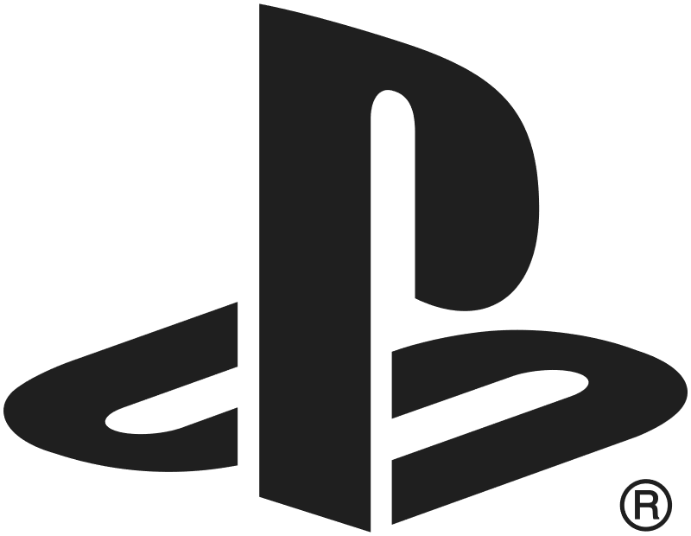
Famous Agile Project Management Success Stories:
In 2014, Sony Interactive Entertainment deployed the Scaled Agile Framework (SAFe) to speed its delivery of new PlayStation releases. The traditional Waterfall technique had proved too slow for the speed of demand. But Scrum on its own was also problematic and failed to create coherence over a network of more than 1,000 engineers.
The SAFe method brought teams into greater alignment. Teams worked in two-week sprints, while Agile Release Trains (ARTs) — essentially, teams of Scrum — met in person every 12 weeks to coordinate. The company’s director of engineering credited SAFe for savings of $30 million in its first year of implementation.
Notes:
Scrum methodology

